Slide 1

Algebra 1
Unit 14, Lesson H1 Creating Relative Frequency Tables Volume 2, pg. 325

Slide 2


Benchmarks
MA.912.DP.3.2
Given marginal and conditional relative frequencies, construct a two-way relative frequency table summarizing categorical bivariate data.
MA.912.DP.1.1
Given a set of data, select an appropriate method to represent the data depending on whether it is numerical or categorical data, and on whether it is univariate or bivariate.
MA.912.DP.1.2
Interpret data distributions represented in various ways. State whether the data is numerical or categorical and whether it is univariate or bivariate, and interpret the different components and quantities in the display.
volume 2, pg. 325

Slide 3
Integrated Mathematical Thinking and Reasoning Standards
MA.K12.MTR.1.1 Actively participate in effortful learning both individually and collectively.
MA.K12.MTR.2.1 Demonstrate understanding by representing problems in multiple ways.
MA.K12.MTR.3.1 Complete tasks with mathematical fluency.
MA.K12.MTR.6.1 Assess the reasonableness of solutions.
MA.K12.MTR.7.1 Apply mathematics to real-world contexts.
volume 2, pg. 325

Slide 4

Learning Target
I can construct a two-way relative frequency table.
volume 2, pg. 325

Slide 5

Warm-Up
volume 2, pg. 325

Slide 6
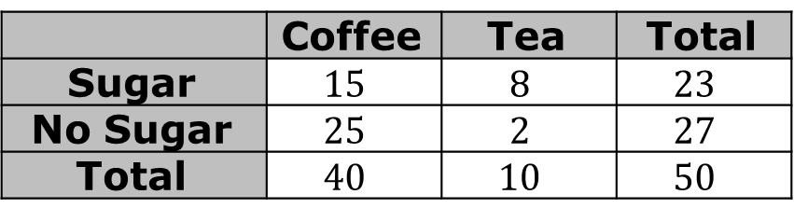
14.H1.1 Warm-Up: What Percentage?
Mindy is in charge of ordering supplies for the break room at her workplace, so she surveys her coworkers. She asks them if they prefer coffee or tea and whether or not they like sugar in their beverages. Her findings are shown in the two-way table.
 | Coffee | Tea | Total
Sugar | $$15$$ | $$8$$ | $$23$$
No Sugar | $$25$$ | $$2$$ | $$27$$
Total | $$40$$ | $$10$$ | $$50$$
Use the two-way table to answer the following questions.
What percentage of people surveyed prefer coffee?
What percentage of people surveyed drink tea with sugar?
volume 2, pg. 325

Slide 7

Exploration
volume 2, pg. 326

Slide 8

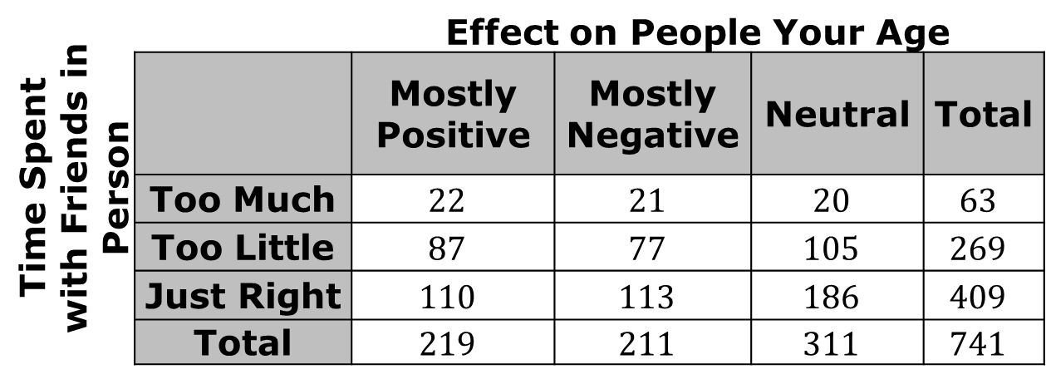
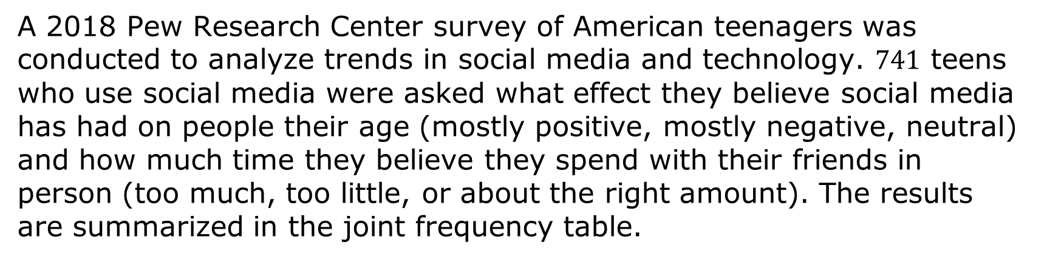
14.H1.2 Exploration: Two-Way Relative Frequency Tables
A 2018 Pew Research Center survey of American teenagers was conducted to analyze trends in social media and technology. $741$ teens who use social media were asked what effect they believe social media has had on people their age (mostly positive, mostly negative, neutral) and how much time they believe they spend with their friends in person (too much, too little, or about the right amount). The results are summarized in the joint frequency table.
Time Spent with Friends in Person |  | Effect on People Your Age
 |  | Mostly Positive | Mostly Negative | Neutral | Total
 | Too Much | $$22$$ | $$21$$ | $$20$$ | $$63$$
 | Too Little | $$87$$ | $$77$$ | $$105$$ | $$269$$
 | Just Right | $$110$$ | $$113$$ | $$186$$ | $$409$$
 | Total | $$219$$ | $$211$$ | $$311$$ | $$741$$
volume 2, pg. 326

Slide 9
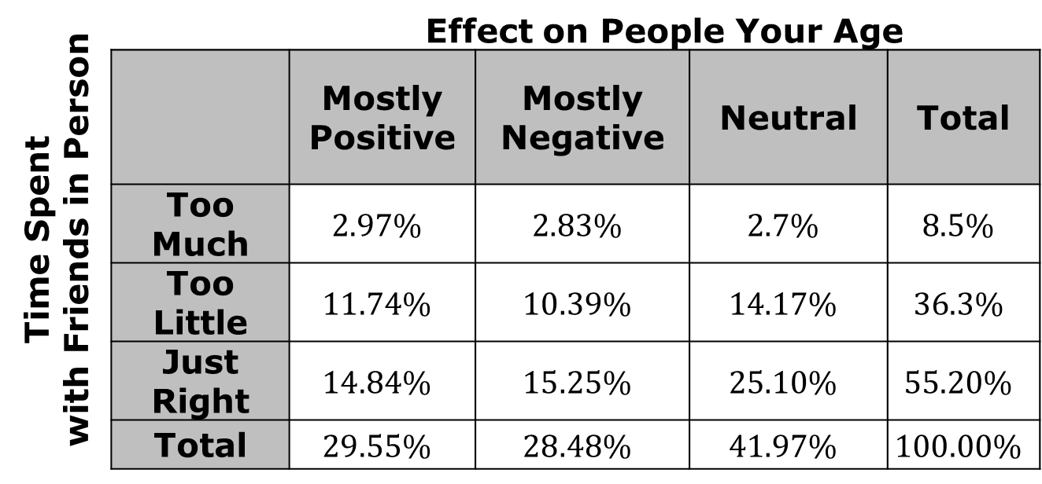
The data can also be displayed in a joint relative frequency table, where the cells represent the joint and marginal relative frequencies. These are often useful to construct when given percentages for a data set, rather than frequencies.
Time Spent with Friends in Person |  | Effect on People Your Age
 |  | Mostly Positive | Mostly Negative | Neutral | Total
 | Too Much | $$2.97\%$$ | $$2.83\%$$ | $$2.7\%$$ | $$8.5\%$$
 | Too Little | $$11.74\%$$ | $$10.39\%$$ | $$14.17\%$$ | $$36.3\%$$
 | Just Right | $$14.84\%$$ | $$15.25\%$$ | $$25.10\%$$ | $$55.20\%$$
 | Total | $$29.55\%$$ | $$28.48\%$$ | $$41.97\%$$ | $$100.00\%$$
volume 2, pg. 326

Slide 10

A joint relative frequency is the ratio of a joint frequency and the total number of data points.
A marginal relative frequency is the ratio of a marginal frequency and the total number of data points.
volume 2, pg. 326

Slide 11
What is the sum of the joint relative frequencies?
What is the sum of the marginal relative frequencies for the variable “effect on people your age?”
What is the sum of the joint relative frequencies for those who believe the effect of social media is mostly positive?
volume 2, pg. 326

Slide 12
What is the sum of the joint relative frequencies for those who believe they spend too much time with friends in person?
Use only the values from the joint frequency table to answer the following questions.
What percentage of those who spend too much time with friends in person believe that the effect of social media has been mostly positive?
What percentage of those who spend too much time with friends in person believe that the effect of social media has been mostly negative?
volume 2, pg. 327

Slide 13
The percentages calculated in Parts A and B above are conditional relative frequencies.
A conditional relative frequency is the ratio of a joint relative frequency to a marginal relative frequency. Equivalently, the ratio of a joint frequency and a marginal frequency.
volume 2, pg. 327

Slide 14

Guided Instruction
volume 2, pg. 327

Slide 15
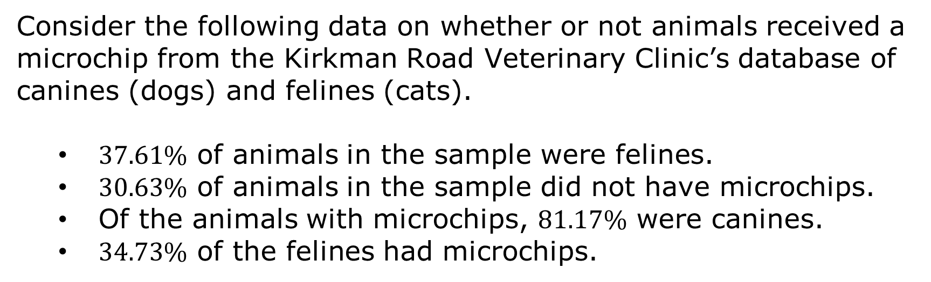
14.H1.3 Guided Instruction: Creating a Two-Way Relative Frequency Table
Consider the following data on whether or not animals received a microchip from the Kirkman Road Veterinary Clinic’s database of canines (dogs) and felines (cats).
$37.61\%$ of animals in the sample were felines.
$30.63\%$ of animals in the sample did not have microchips.
Of the animals with microchips, $81.17\%$ were canines.
$34.73\%$ of the felines had microchips.
volume 2, pg. 327

Slide 16
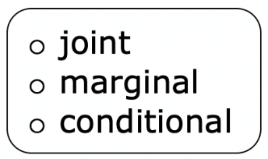
Complete each statement.
$37.61\%$ represents a relative frequency.
$30.63\%$ represents a relative frequency.
$81.17\%$ represents a relative frequency.
$34.73\%$ represents a relative frequency.
volume 2, pg. 327

Slide 17

Explain how to determine the relative frequency of microchipped canines in the sample.
The value in question 2 represents a relative frequency.
volume 2, pg. 328

Slide 18
Use the data to create a joint relative frequency table. Space is provided to make any calculations.
Clients at Kirkman Road Veterinary Clinic
 | Microchipped | Not Microchipped | Total
Feline
Canine
Total
volume 2, pg. 328

Slide 19
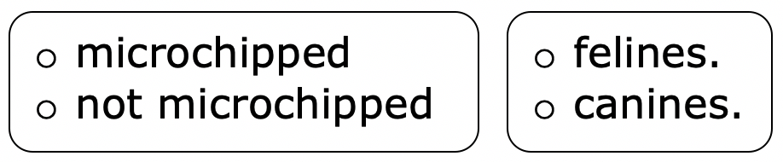
Complete the statement.
The smallest percentage of animals in the sample were
What percentage of canines had microchips?
Which kind of pet is more likely to be microchipped? Explain your reasoning.
volume 2, pg. 328

Slide 20

Guided Practice
volume 2, pg. 329

Slide 21

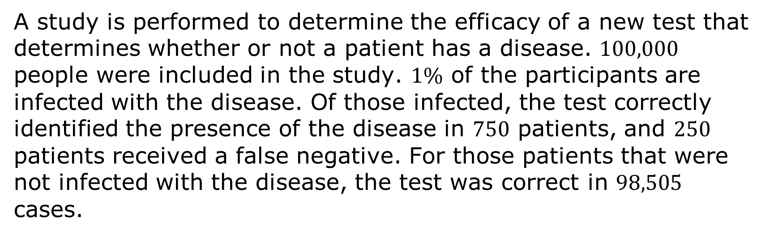
14.H1.4 Guided Practice: Creating a Two-Way Relative Frequency Table
A study is performed to determine the efficacy of a new test that determines whether or not a patient has a disease. $100,000$ people were included in the study. $1\%$ of the participants are infected with the disease. Of those infected, the test correctly identified the presence of the disease in $750$ patients, and $250$ patients received a false negative. For those patients that were not infected with the disease, the test was correct in $98,505$ cases.
volume 2, pg. 329

Slide 22
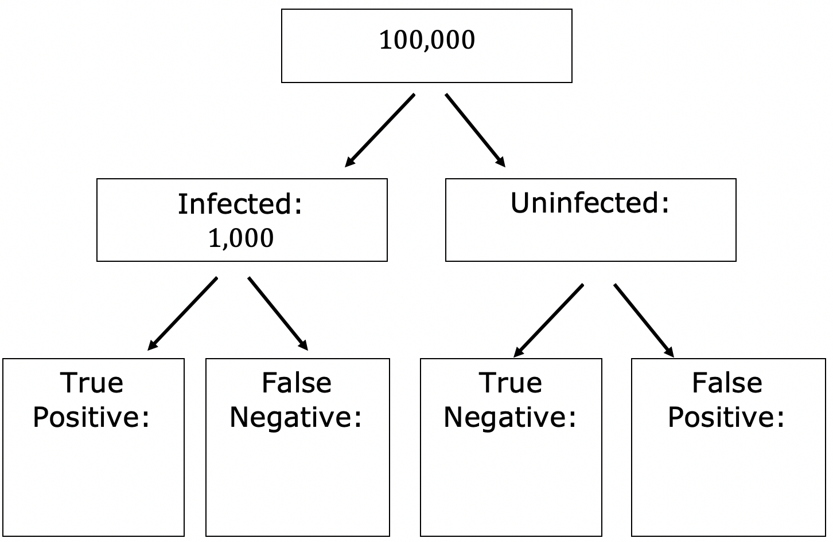
Use this data to complete the tree diagram.
volume 2, pg. 329

Slide 23
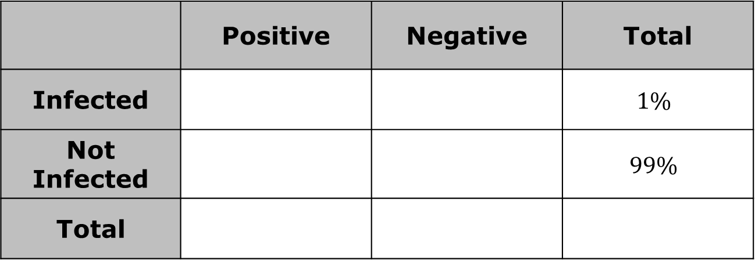
Complete the two-way relative frequency table to represent the data.
 | Positive | Negative | Total
Infected |  |  | $$1\%$$
Not Infected |  |  | $$99\%$$
Total
volume 2, pg. 329

Slide 24

Try It
volume 2, pg. 330

Slide 25

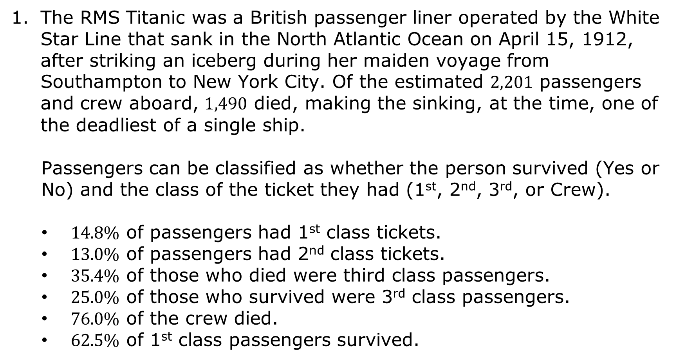
14.H1.5 Try It: RMS Titanic
The RMS Titanic was a British passenger liner operated by the White Star Line that sank in the North Atlantic Ocean on April 15, 1912, after striking an iceberg during her maiden voyage from Southampton to New York City. Of the estimated $2,201$ passengers and crew aboard, $1,490$ died, making the sinking, at the time, one of the deadliest of a single ship.
Passengers can be classified as whether the person survived (Yes or No) and the class of the ticket they had (1st, 2nd, 3rd, or Crew).
$14.8\%$ of passengers had 1st class tickets.
$13.0\%$ of passengers had 2nd class tickets.
$35.4\%$ of those who died were third class passengers.
$25.0\%$ of those who survived were 3rd class passengers.
$76.0\%$ of the crew died.
$62.5\%$ of 1st class passengers survived.
volume 2, pg. 330

Slide 26
Create a two-way relative frequency table based on the data provided.
 | Survived
Ticket | No | Yes | Total
1st
2nd
3rd
Crew
Total
volume 2, pg. 330

Slide 27

Wrap-Up
volume 2, pg. 330

Slide 28
14.H1.6 Wrap-Up: Reflection
Complete each statement.
After today’s lesson, I am still unsure about ...
To fill this gap, I intend to ...
volume 2, pg. 330

